Slide 1
Definition of Decision Tree algorithm
Decision Tree algorithm :
It is idea about the creating a Tree like structure for the entire data & process a single outcome at every leaf (or minimize the error in every leaf)
Decision Tree is a Supervised learning technique that can be used for both classification and Regression problems, but mostly it is preferred for solving Classification problems.
It is a tree-structured classifier, where internal nodes represent the features of a dataset, branches represent the decision rules and each leaf node represents the outcome
Every node represents a future(attribute), each link(branch) represents a decision(rule) and each leaf represents an outcome.(categorical or continuous value).

Slide 2

General structure of decision Tree

Slide 3
Definition of root node, decision node & leaf node
root node : Root node is from where the decision tree starts. It represents the entire dataset, which further gets divided into two or more homogeneous sets.
decision node : Decision nodes are used to make any decision and have multiple branches
leaf node : whereas Leaf nodes are the output of those decisions and do not contain any further branches..

Slide 4
Entropy
Entropy is a metric to measure the impurity in a given attribute. It specifies randomness in data. Entropy can be calculated as:
Entropy(s)= -P(yes)log2 P(yes)- P(no) log2 P(no)
Where,
S= Total number of samples
P(yes)= probability of yes
P(no)= probability of no

Slide 5
Process of selecting the root node
There are couple of algorithms there to build a decision tree
1.gini index :
Gini index for all the features is calculated (Except target attribute)
Feature having less gini index value is selected for root node
2.ID3 (iterative Dichotomiser):uses entropy function and information gain as metrics.
Pick the highest gain attribute as a root node

Slide 6
Gini index or Gini impurity
Measures the impurity of the nodes
0- purity
1- impurity
0.5 – equal distribution
While designing the decetion tree less value preferred.

Slide 7
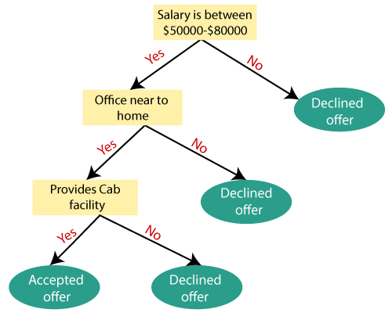
Example

